Slide 1
Data Science Interview: Bart Watson, Chief Economist, The Brewers Association
Interview By: Spencer Swartz,
MSDS Candidate, University of Wisconsin – La Crosse

Slide 2
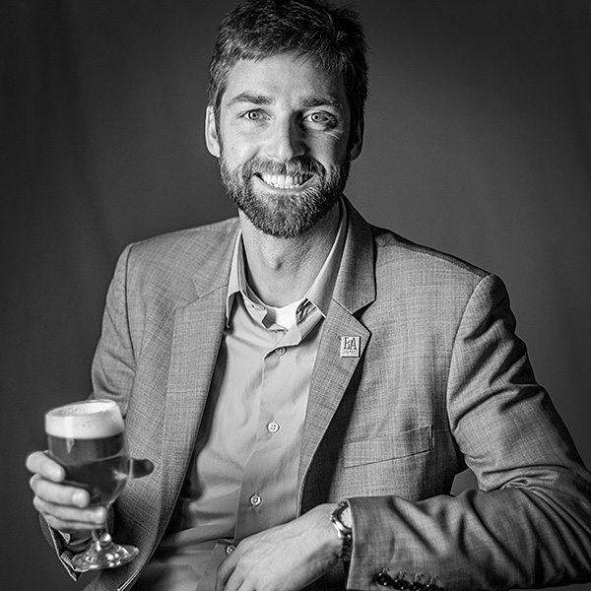




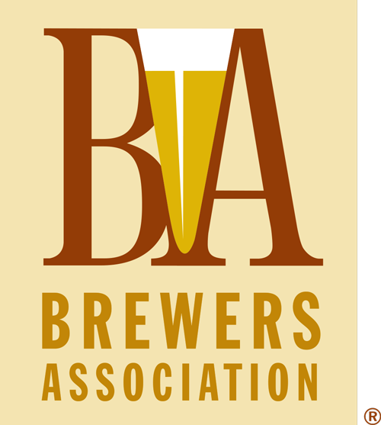
Bart Watson - Background
Education
BA, Political Science
UC Berkeley
PhD, Political Science
Stanford
Career
Lecture – UC Berkeley
2011-2012
Associate – The Barthwell Group
2011-2013
Visiting Assistant Professor – U of Iowa
2012-2013
Chief Economist – The Brewers Association
2013- Present

Slide 3
The Brewers Association
Purpose
To promote and protect American craft brewers, their beers and the community of brewing enthusiasts.
About
The Brewers Association is a 501(c)(6) not-for-profit trade association. The association is an organization of brewers, for brewers and by brewers. More than 4,300 U.S. brewery members and 46,000 members of the American Homebrewers Association are joined by members of the allied trade, beer wholesalers, retailers, individuals, other associate members and the Brewers Association staff to make up the Brewers Association.

Slide 4
disposition
Bart has somewhat fallen into the field of Data Science, because of this he has a very unique point of view on the subject.
Although his path into Data is somewhat non-standard (some would say he's an accidental analyst), he realized somewhat early in his career that being able to tell a story with data was an important skill.
Bart believes that there is a lot of room for Data Science in the somewhat young industry that is craft beer, because of this he is both excited for change that will come with data, as well as the fact that he has the ability to jump in on the ground floor.
Although Bart’s title is Chief Economist and has no obvious tie to either his background in Political Science or Data Science, he is excited for the somewhat openness of his role and his ablility to learn (mostly the Data Science side) while being on the job.

Slide 5
professionalism
Bart is often working remotely for BA at various trade conferences, it is there where he gets a lot of data related ideas, this requires him to be able to strike up a rapport with fellow BA members to identify questions and problems that they have, and try to identify way that data may be able to expose or solve the problems.

Slide 6
What I learned
Although Data Science is currently a well sought after skill and position, there are still a lot of people that fall into the role that never would have expected to.
Similar to the above for Bart it was kind of a surprise to be end up at a place like the Brewers Association, he never expected to be in the beer world when studying in Political Science.
To his point every one should be open and willing to go in a different direction, you may end up loving it

Slide 7
Improving the Flow of Information
As mentioned in earlier slides, Bart never expected to be in a Data Science role, because of this, the training that he has is somewhat self-taught. For him the need for a new skill only arises when he realizes its needed, he believes that it is possible that this approach, although an exciting way to learn, could cause him to miss out on techniques that may be better suited to the task.

Slide 8
Data Science At The Brewers Association
Bart wears many hats at BA, to him this is exciting as no two days are the same.
This provides clarity as to why he has worked on so many Data Science related activities while having the title of Chief Economist
It seems that the culture at BA is one where everyone pitches in regardless of there skill set, if there is a need for help every one is on board.
This type of culture is exciting to me and would be interesting be a part of, but it is possible that some people would not enjoy this as they expect to only preform tasks within there role.
Bart often mentions that the work I am doing as a part of my Capstone project is just “cream on top”, the company is very busy and likely would not have had the time to work on it themselves, this makes it seem that there is a plethora of interesting projects that could be done as a Data Scientist at BA.

Slide 9
Appendix

Slide 10
Appendix – A Questions Asked
Given that your background is somewhat a non-typical path to Data Science (coming mainly from an Economics skill set) what drew you to the field of data science and telling the story your economic insights with data?
You have a lot of interesting data related blog posts on BA’s website. Are these articles a good representation of your day to day work at BA? What other activities do you partake in? Would you say they also have a relation to Data Science?
(Related to the above) How do you approach a data science project like the ones represent within your BA blog? Do you consider questions your members submit, or BA has determined relevant?
Being a part of a mission driven non-profit organization, do you think there are district use cases for data and analysis that are not seen as necessary in a more traditional for-profit organization?
What skills have been important for you to be successful in your field, and what aspects do you think fit will within data science?
As mentioned earlier, your position is likely not what most people initially think of when they think of Data Science, given your unique point of view, what forces (people, ideas, or otherwise) influenced you to pursue a career in Economics and somewhat unintentionally the field of data science?
You have mentioned in conversations before that some of your data comes from surveys competed by you members, Is this the sole source of data you use? How do you prepare and gather this information and other data points relevant to a project you are working on?
Data Science takes a lot of knowledge in areas like statistics, math and STEM related domains, but what many don’t realize is that communications is very important to the field as well. How important has communication been for you to be able to share your findings skills in your career field?
At times it can be difficult to get buy in for data science related projects, have you ever ran in to a similar situation? If so, what's steps did you take to create buy with your leadership to get a project started?
What are some of the emerging trends currently taking place in the field of data science and is connections to Economics?
Do you have any advice as to ways you stay up today within you field while being a contributor to company? In what ways do you try to balance your career with continuous learning?
What advice would you pass along to someone looking to have a successful career in the field of data science?

Slide 11

Appendix – B Interview recording

